Slide 1
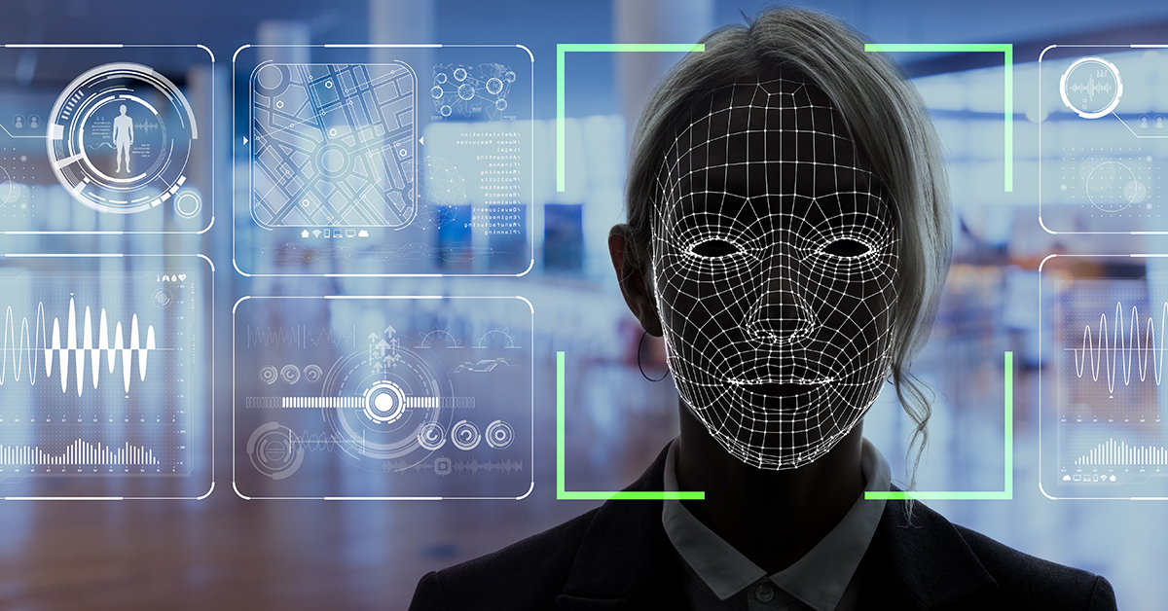
FACIAL RECOGNITION BASED ATTENDANCE SYSTEM

